Slide 1
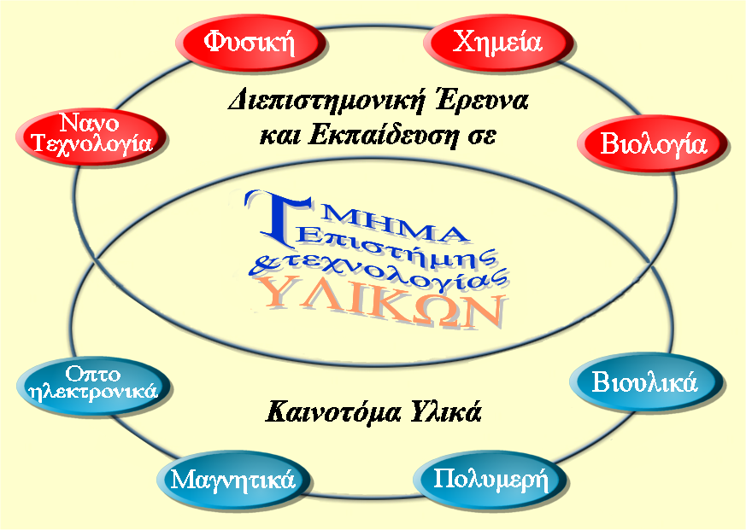
Department of Materials Science and Technology
University of Crete
A brief presentation of the Department
Prof. Anna Mitraki

Slide 2
Academic numbers of the Department
  Undergrads: ~900 total (180/year)
  Post-grads: 33 MSc + 64 PhD
  Faculty: 19 (6 women, 13 men)
  Lab staff: 6, Technical staff: 2
  Administrative personnel: 5
  Visiting/contract instructors: ~4-5/year
  Alumni: ~396 Undergrads,
  ~146 (86 MSc-60 PhD) postgrads

Slide 3
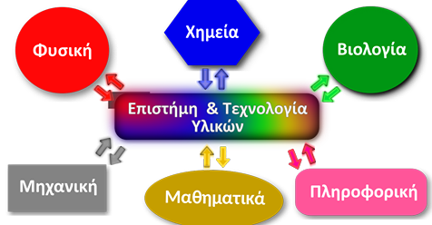
EDUCATIONAL GOALS :
-theoretical and experimental education of the students in materials science
Towards
creation of highly formed scientists that can stand in the international job market in Academia and Industry

Slide 4
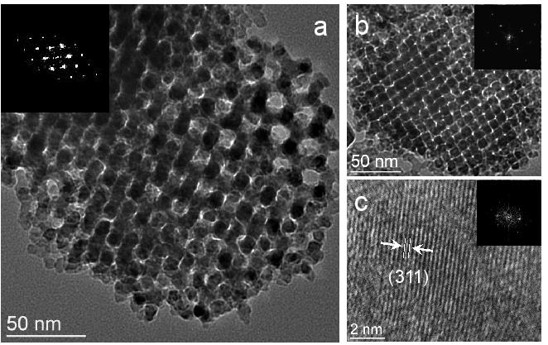
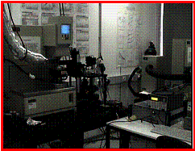
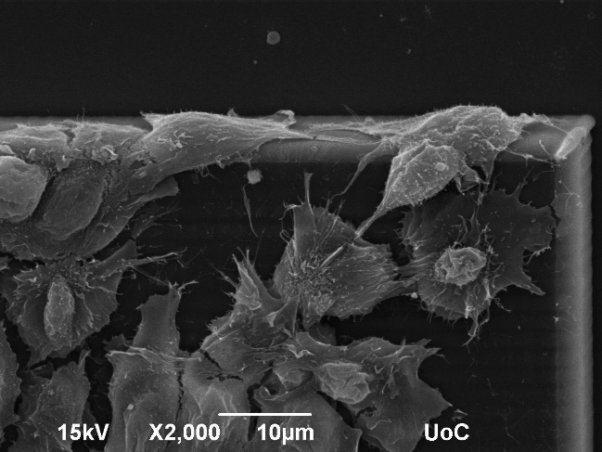
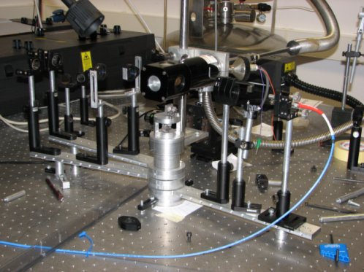
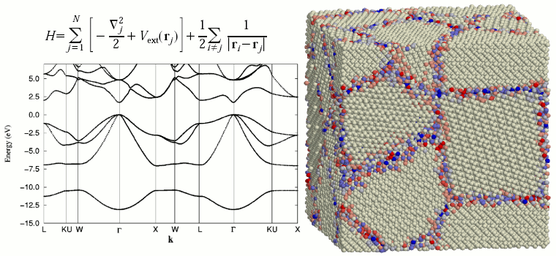
Interdisciplinary profile and training
Materials
chemistry
Polymer/
colloid science
Biomaterials
Optoelectronics / magnetic Theoretical / experimental Materials Science

Slide 5
Implementation : three Curriculum stages
Introductory stage (Semesters: 1-3)
Basic introductory courses in Mathematics, Physics, Chemistry, Materials Science, Computers
Educational goals:
-buildup of solid science understanding
Educational goals:
-buildup of Solid Materials Science knowledge
-consolidation of laboratory skills
Basic stage: (Semesters: 4-6)
Focus on Material Science courses, introductory Biochemistry courses, laboratory courses
Advanced stage (Semesters: 7-8)
“Direction courses ” in the various classes of materials
Elective courses from the Dept and other Depts
Diploma thesis
Educational goals:
-specialization in areas of interest
-preparation for graduate studies / professional life

Slide 6
Five Basic Axes of Quality strategy
1. Focus on building the Learning process
2. Maintaining high education standards and high levels of scientific output
3. Attuned to emerging educational needs and incorporation in the curriculum
4. Science communication and public outreach
5. striving for constant connection links
of education with employment perspectives

Slide 7
Focus on building the Learning process
1
  a. Changing the “accumulation of knowledge model” followed in the Greek secondary education
  b. Building of independent and creative thinking
  c. Encouragement of questioning, bibliographical searching, etc.
d. Building of “problem solving” skills

Slide 8
Maintaining high educational and scientific standards
2
a. Constant contact and interaction with the national and international scientific scene
b. (Synergies with other Depts, Medical school, and FORTH Institutes – international collaborations /exchange, etc)
c. Creation of motives for students
(practical training, ERASMUS+, fellowships, contribution to research output)
d. Recruitment of highly motivated junior faculty members from abroad

Slide 9
Attuned to emerging educational needs and their incorporation in the curriculum
3
Examples :
a. introduction of a new course “Nanomaterials for Energy and Environment” (ETY-346), academic year 2019-20
b. introduction of three new courses, on the “Economic dimensions of Materials” academic year 2019-20
  On intellectual property, innovation, Entrepreneurship
  (ETY-205, 207, 209)
  Taught by Dr. Trichas, PhD in Materials Science, MBA
  Offered to all School of Science Depts

Slide 10
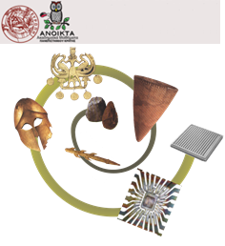
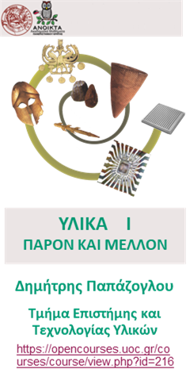
Science communication and public outreach
4
a. ΛΗΜΜΑ «ΕΠΙΣΤΗΜΗ ΤΩΝ ΥΛΙΚΩΝ» ΣΤΗΝ ΕΛΛΗΝΙΚΗ WIKIPEDIA
https://el.wikipedia.org
b. Open UoC courses
c. Social networks,
articles in local /National press (eg. «Καθημερινή», 14.10.2020)
https://www.kathimerini.gr/society/561116101/meteoroi-apofoitoi-para-tin-exeidikeysi/
d. Networking and connecting alumni with students

Slide 11
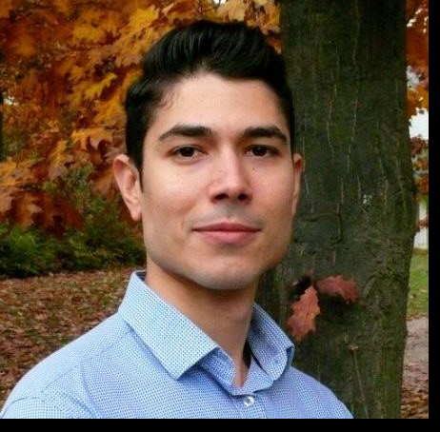
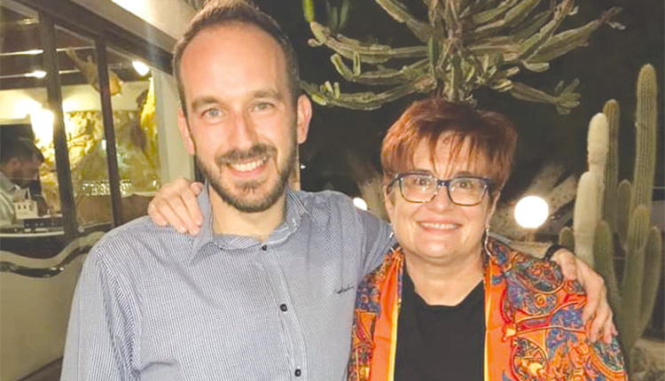
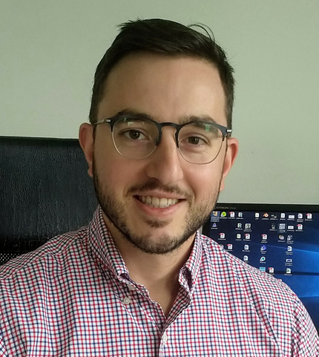
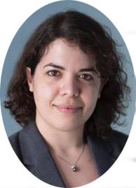
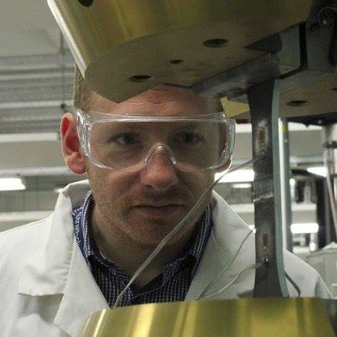
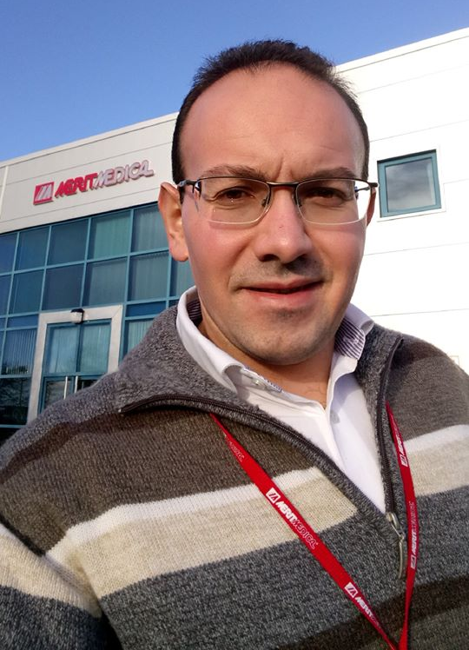
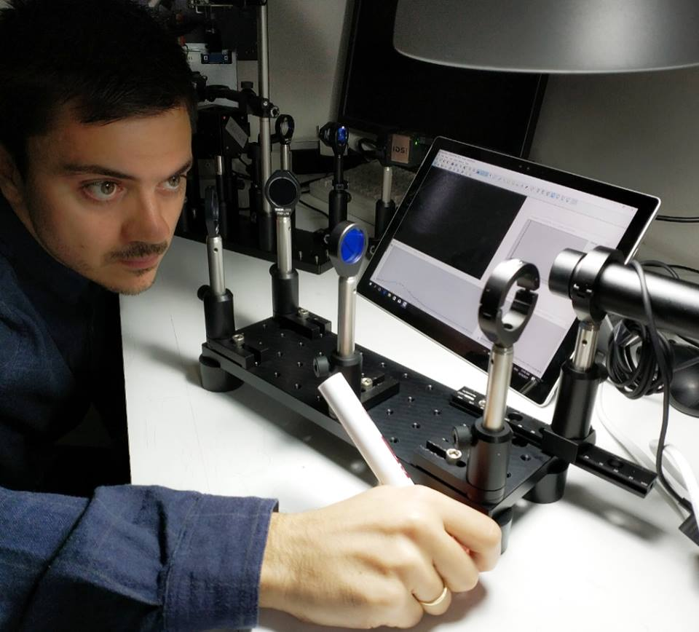
Our graduates…..
#tetyalumni
www.materials.uoc.gr

Slide 12
Constant connection links
of education with employment
5
a) inviting successful graduates to speak at graduation ceremonies, advertising positions at their industrial or academic affiliations in the Department web pages
b) maintaining constant connection with employers and social partners
c) follow-up of practical training, ERASMUS placements
d) encouragement of entrepreneurship

Slide 13
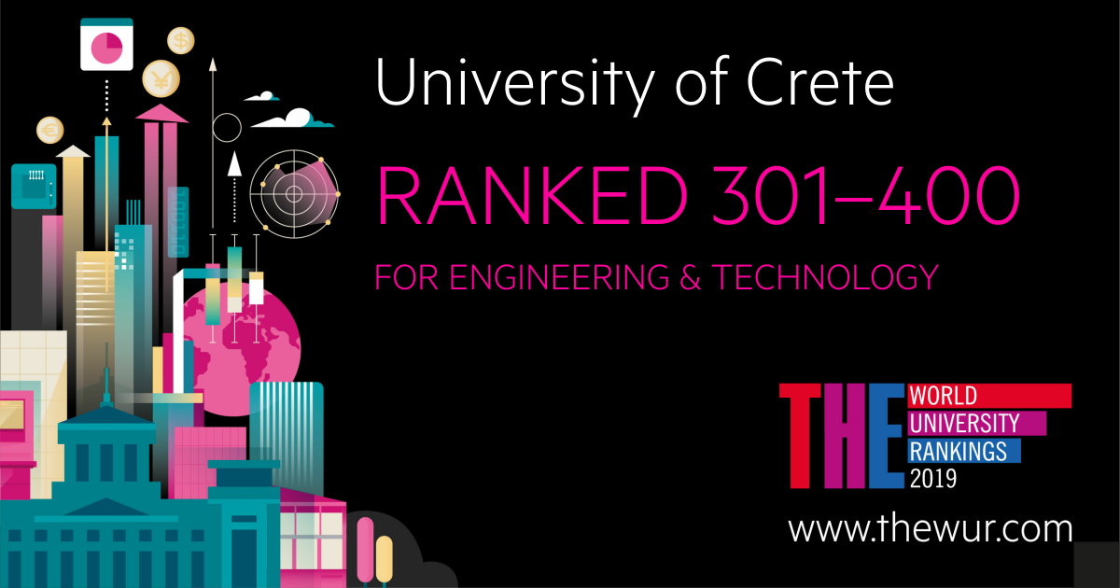
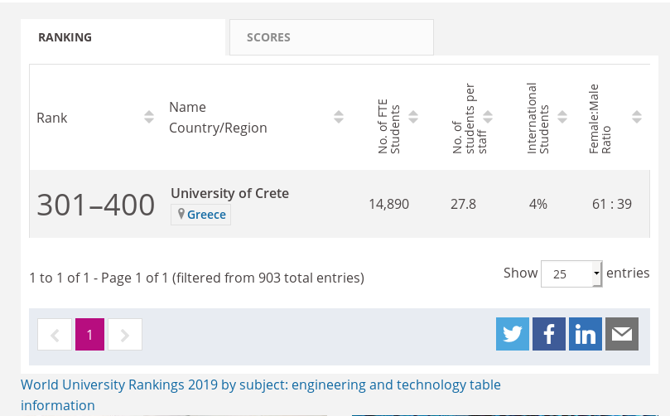
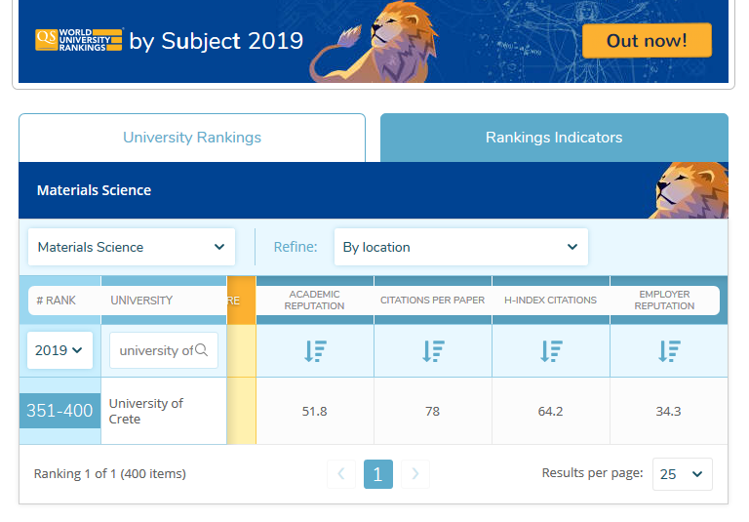
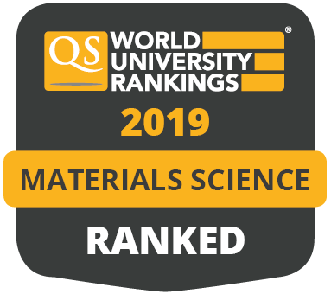
Department rankings
Times Higher Education World University Rankings (2019)
No 386 of World Materials Science Depts, QS University Rankings (2019)
01/12/2020
13

Slide 14
Overall quality strategy

Slide 15
SWOT analysis
Strengths
Weaknesses
Established Department based on international standards
Academic staff with international contacts, visibility & intense activity in national/international collaboration schemes & funding
International distinctions and high ranking
State of the art infrastructure / access to UoC/FORTH
Modern & well structured undergraduate programme providing high quality scientific education
The undergraduate programme combines basic sciences & interdisciplinary subject of materials science, offering broad career perspectives to the graduates
(MST graduates pursue successful careers in academia/industry worldwide)
Good balance between female/male students
Materials Science not well-known field in Greece
Graduates do not have professional rights in Greece
(Lack of professional rights leads to loss of positions in materials- science related jobs by other graduates)
Low students entry level
Threats
Very low funding from the state
Very high number of Students Admitted
(Request 50-Get 180.. )
Brain drain leads to the loss of students and academic staff
Crete is isolated from mainland Greece and has relatively high living cost in Heraklion
(Difficult for students to come to Crete for studies due to economic crisis)
Lack of large industry in Crete that could boost MST’s research activities, innovation actions and graduate recruitments
Opportunities
Further expansion of our research activities & research collaboration networks at an international level
Link our research teams & graduates to leading international industrial actors
Attract investment for national & European research infrastructures
Exploit our maturing technologies & Promote spinning-off activities, as well as employment of highly-skilled graduates with minimum gender inequality
01/12/2020
15

Slide 16
Credits
Photos from
  Assoc. Prof. D. Papazoglou
People
  All Faculty members
  Prof. M. Vamvakaki
  Assoc. Prof. D. Papazoglou
  Assoc. Prof. G. Armatas
  Dr. S. Stamatiadis
All members of the department for their work

